Slide 1

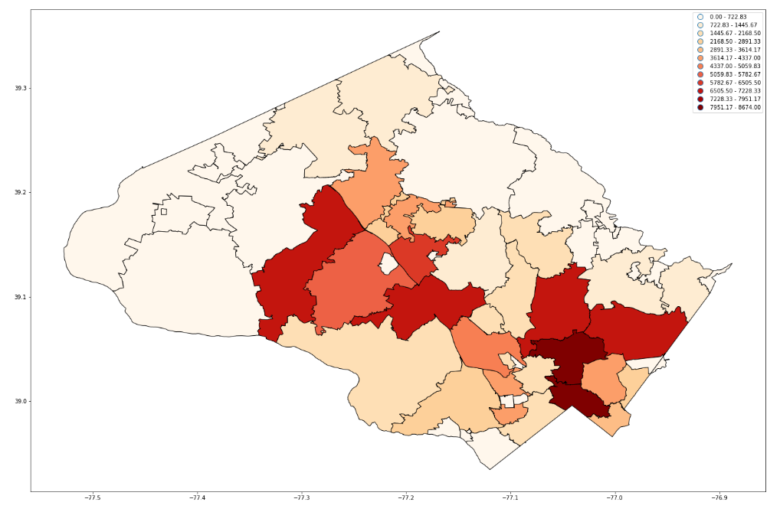
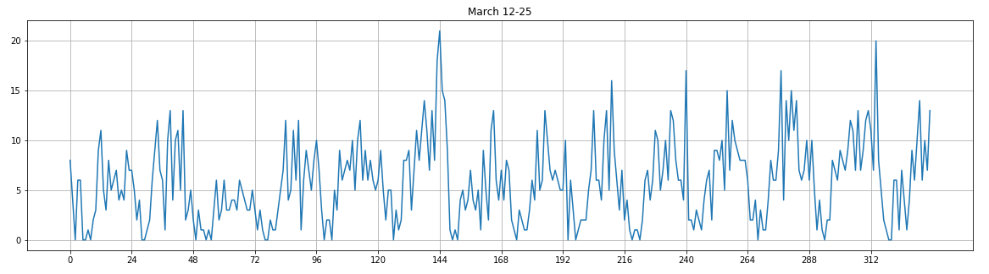
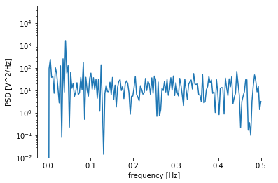
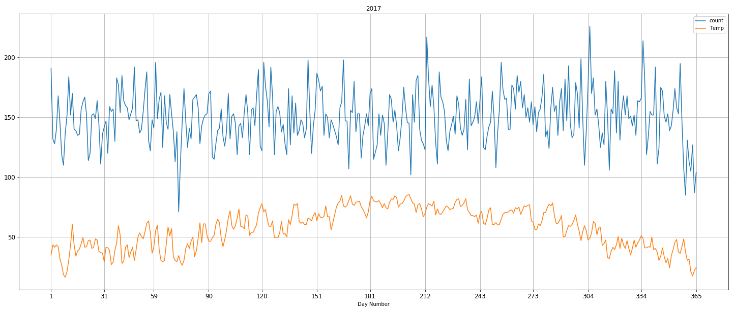
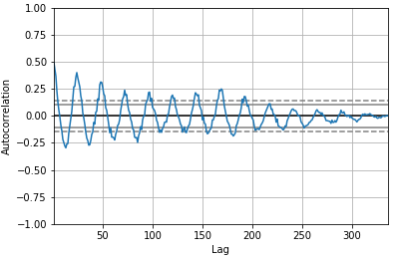

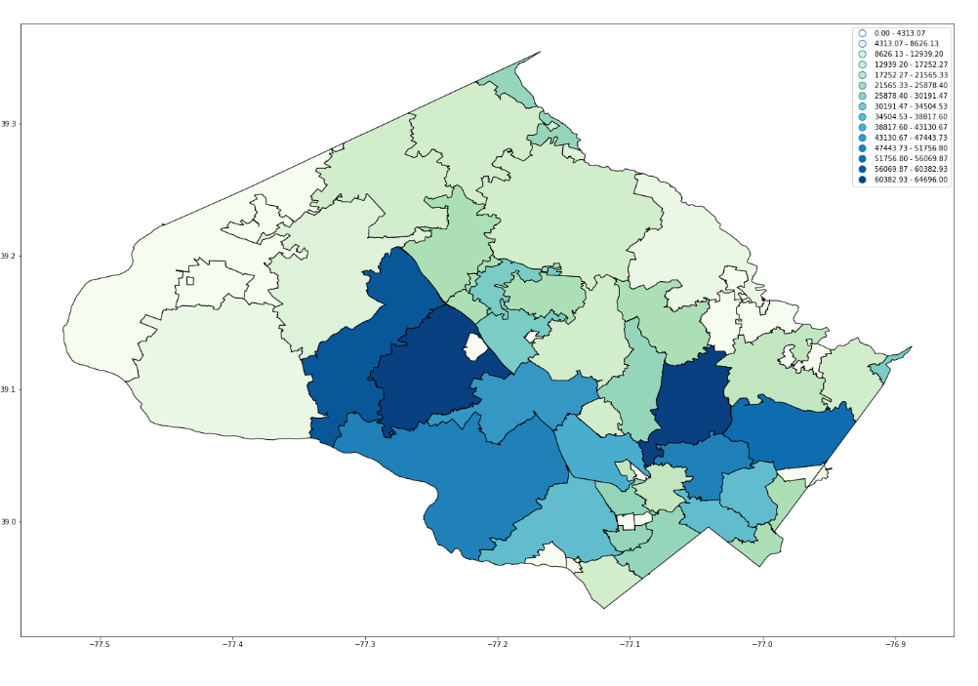
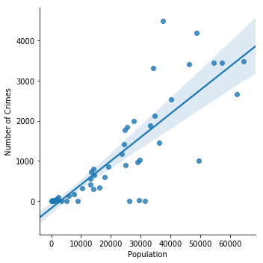
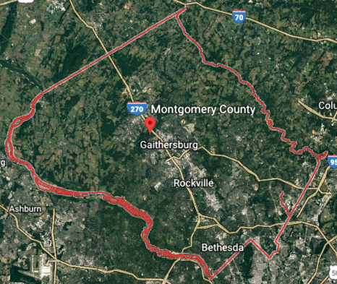
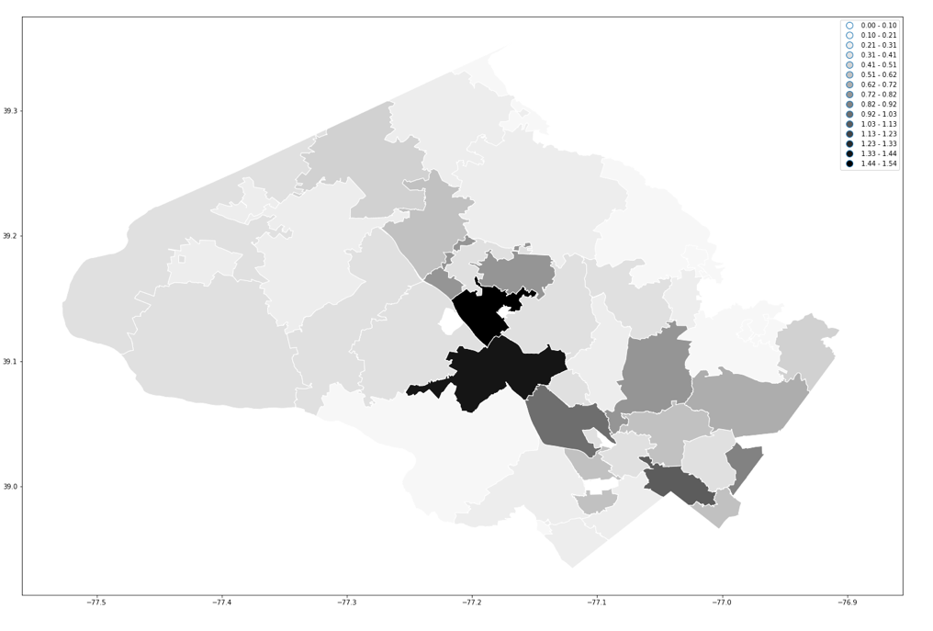
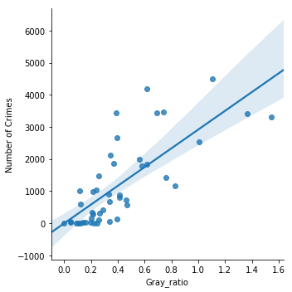

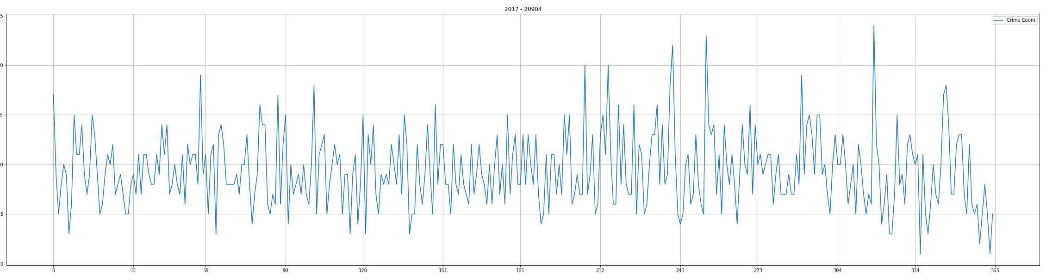
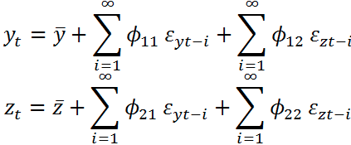
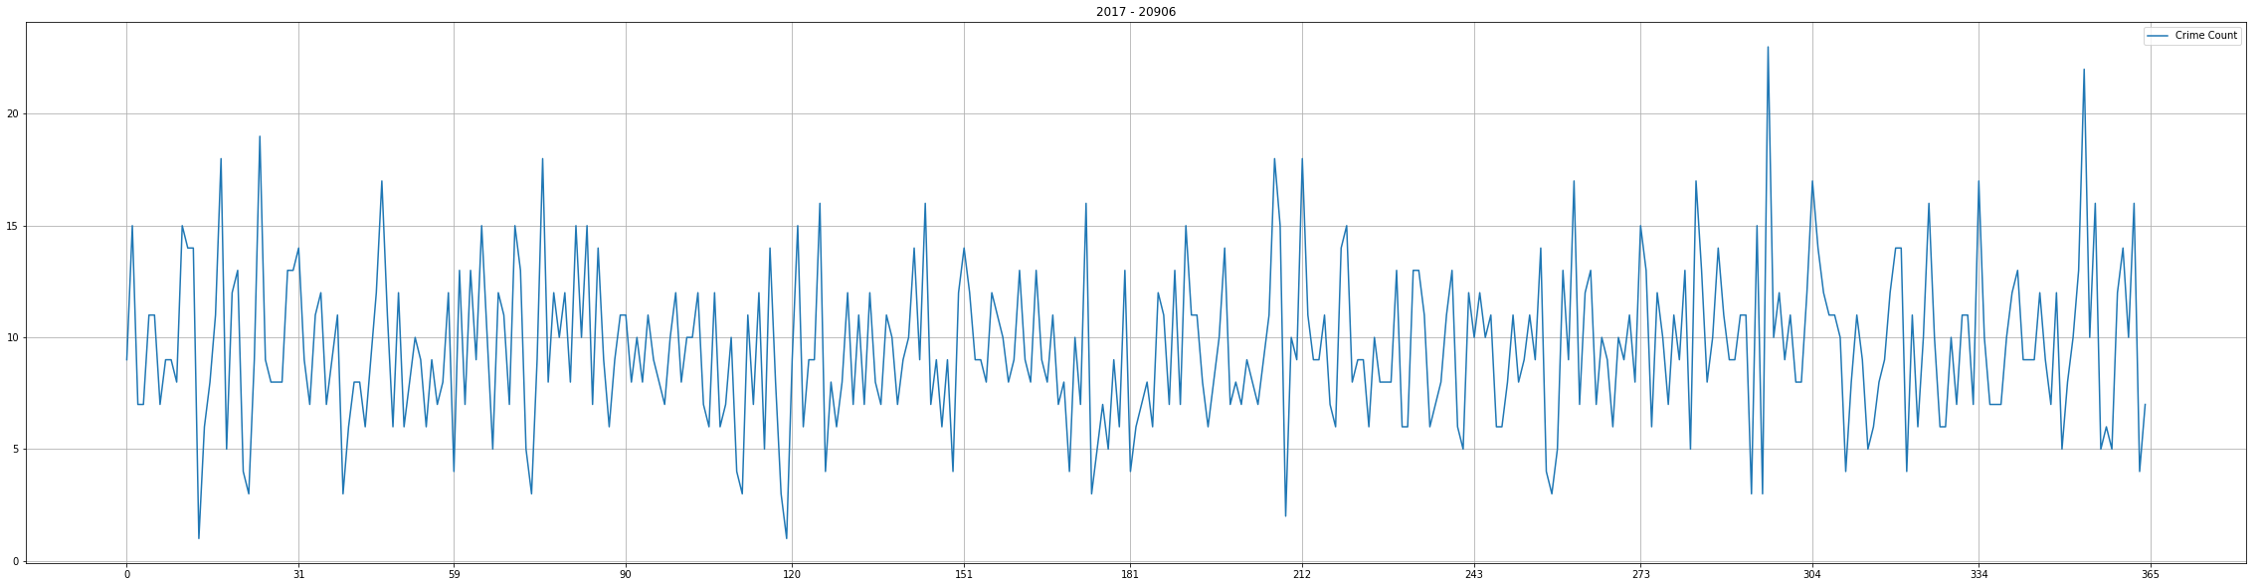
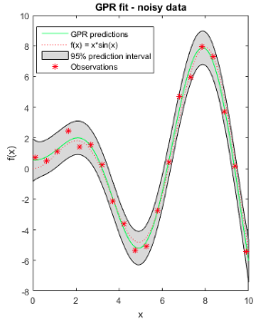
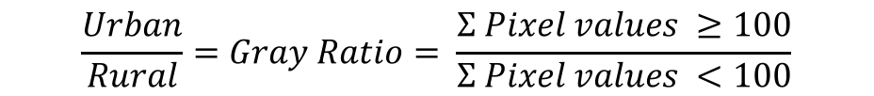
Analyzing Crime Statistics for Smart City Applications
Varshini Selvadurai¹, Aaron Gilad Kusne²
Varshini Selvadurai¹, Aaron Gilad Kusne²
1 Poolesville High School, 2 Materials and Measurement Division NIST
INTRODUCTION
OBJECTIVE
Smart Communities
Montgomery County
Need
Technological advancements lead to a safer and smarter world. The Internet of Things (IoT) is a network of devices such as sensors and software that share information with each other to create a dynamic system that can be used in smart cities. Smart communities are urban areas that use electronically collected data to interpret and analyze similarities in data that can be used to improve city resources, services and predict future patterns. This data can range from energy usage, traffic to environmental data.
An effective community should know how resources should be spread throughout the community. For this reason unconventionally researched data such as crime should be looked at to determine the spread of police stations and officers. Effectively distributing resources will save money and time for the county.
Montgomery County is the most populated and economically well-off county in Maryland. Although Montgomery County is not a smart community with sensors to collect and store data, the county has public records of data that could be used to analyze county statistics. Using machine learning techniques to analyze the crime data, relationships can be found between crime and zip codes. These relationships can help determine future crime patterns. Trends found can help allocate the necessary resources in zip codes with higher crimes rates and prevent crime. With such information Montgomery county can
become a smarter community.
Montgomery County, MD collects and publicly records data:
Machine learning can aid police and emergency services to identify trends in crime, distribute resources more effectively, and potentially stop crimes before they occur
[1]
Goals
Analyze & visualize crime statistics data from Montgomery County
Observe & Identify similarities and patterns in crime and predictors of crime
Use various machine learning technique and the observed patterns in predicting future crime patterns
METHODS
Retrieve Data
Data Wrangling
Machine Learning
Visualization
Relationship Analysis
Identify pertinent data
Unify diverse data types
Investigate data to identify qualitative trends
Quantify found trends
Predict future trends
Visualization & Relationship Analysis
Interested in:
Crime trends over time
Expected:
Daily, Weekly, Monthly and Seasonal trends
Confirmed:
Daily and Weekly seasonality
Daily & Weekly Trends
March 12, 2017 – March 25, 2017
Apparent seasonal weekly trend: spike near end of the week
Periodogram: March 12,2017 – March 25, 2017
The periodogram shows a max spectral density at 24 hours, meaning it is the more prevalent period. There is another noticeable period at 168 hours confirming a period of 7 days.
Temporal
Apparent seasonal daily trend: fall and rise in crime
Frequency: 0.0416 Hz
Period: 24.0 hrs = 1 day
Crime Count
1 day
Spectral Density [V²/Hz]
Frequency: 0.00595 Hz
Period: 168.0 hrs = 7 days
Monthly & Seasonal Trends
Hour (14 days)
No apparent monthly trend – not worth exploring
2017
Crime Count
Temperature
Frequency [Hz]
Autocorrelation: March 12,2017 – March 25,2017
Seasonal trends would depend on Temperature. There is no apparent relationship between the crime count and the temperature → No apparent seasonal trend – not worth exploring
The autocorrelation plot confirms the periodogram
Rise in the plot occurs after 7 peaks → confirms periodogram and confirms a weekly seasonality
Seasonal Trends
Autocorrelation
24
24
24
24
24 …
A peak occurs every 24 lags (hours) → confirms the periodogram and confirms a daily seasonality
Retrieve Data
Monthly Trends
Day Number
Lag
Crime Data – https://data.montgomerycountymd.gov/
Start Date/Time
Zip Code
Population – https://www.census.gov/
Zip Code Boundaries – https://data.montgomerycountymd.gov/
Temperature – https://www.ncdc.noaa.gov/
Satellite Image – https://www.google.com/maps/
Spatial
Crime
Population vs. Crime
Linear regression was used to confirm the visualized correlation between population and crime. An r-value or .83 suggest a strong linear correlation. Although population may not cause crime it may be used to predict it.
Number of Crimes
Interested in:
Crime trends based on demographics of different zip codes
Expected:
Population, Urban/Rural Ratio, Avg. House Price
Confirmed:
Population, Urban/Rural Ratio
Population
Population
Data Wrangling
Gray Ratio vs. Crime
By comparing the gray ratio to the number of crime incident in every zip code a strong linear correlation with an r-value of .76 was found. This suggests that there may be a difference in crime level in rural verse urban areas.
Data | Format | Converted to
Crime | Excel | Excel
Population | csv | Excel
Temperature | csv | Excel
Zip Code Boundary | shp | shp
Satellite Image | shp | shp
Number of Crimes
Google Earth
Urban:Rural Ratio Analysis
Gray Ratio
$$\frac{Urban}{Rural}=Gray Ratio= \frac{Σ Pixel values ≥100}{Σ Pixel values <100}$$
Rural Urban
MACHINE LEARNING
Spatiotemporal Trends
We have a variety of spatial and temporal data. By combining these qualities, we can assess trends regarding crime over time for different zip codes
Granger Causality:
A statistical test that is used to determine whether one time series can forecast another
20904
Using the granger test, the relationship between crime rates of 5 zip codes that have the highest number of crime incidents: 20910, 20902, 20904, 20904, 20874, can be analyzed. The granger test has been conducted for each pair of the 5 zip codes, but no conclusions have been drawn yet. Once 2 zip codes with a strong relationship have been identified, it will be exploited.
Exploit:
Vector auto-regression and Gaussian processes will be used to exploit the relationships and predict crime based in them.
Vector Auto-Regression
[2]
Expected:
The number of crime incidents in one zip code can be used to predict crime incidents in another zip code
20906
Gaussian Process
[3]
Visualization:
The trend we expect can not be easily visualized. We must verify it’s existence using the Granger Causality
Gaussian Process outputs a prediction with uncertainty. Vector auto-regression does not provide an uncertainty.
[1] https://data.montgomerycountymd.gov/
[2] https://masterofeconomics.org/2011/04/19/factors-influencing-inflation-at-different-forecast-horizons-variance-decomposition-of-a-vector-autoregression/
[3] https://www.mathworks.com/help/stats/gaussian-process-regression-models.html

